Slide 1
Extract, transform, load
MTN.BI.08
Data Vault
Elias Nema
Lead Software Engineer
Elias_Nema@epam.com

Slide 2
Agenda
Data Vault Modeling
Unit Testing
Hierarchies in Dimensions
ACT_ Views

Slide 3
Data vault

Slide 4
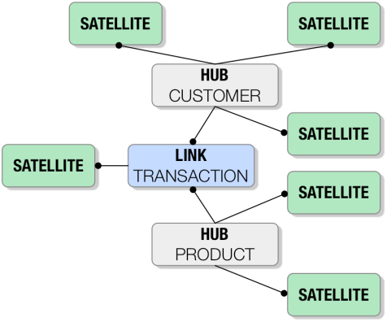
Hubs, Links, Satellites

Slide 5
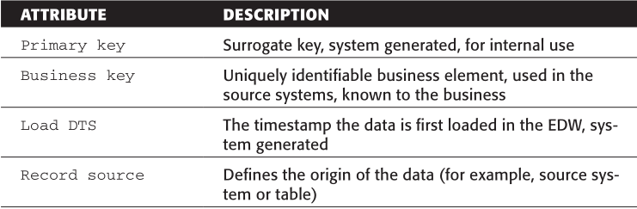
Hubs
The Hub is a business key recording device
The Hub entity must NEVER contain foreign keys.

Slide 6
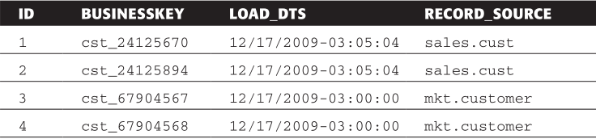
Sample Hub

Slide 7
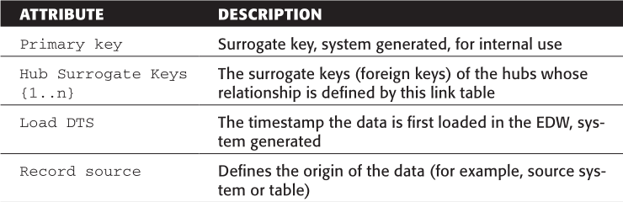
Links
Links provide flexibility to the Data Vault model by allowing change to the structure over time. It provides mutability of the model without loss of history.
A Link must have more than one parent table.

Slide 8
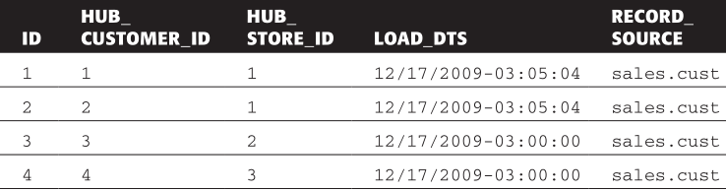
Sample Link

Slide 9
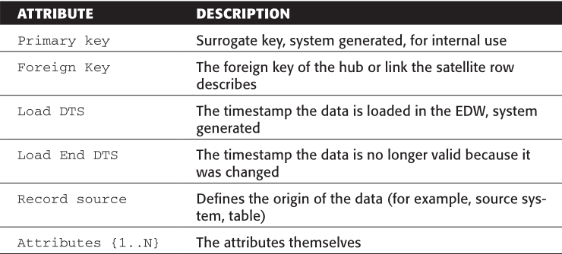
Satellites
Descriptive data in warehouses often changes; the purpose of the Satellite is to capture all deltas (all changes) to any of the descriptive data which occurs.
The purpose of the Satellite is to provide context to the business keys.

Slide 10
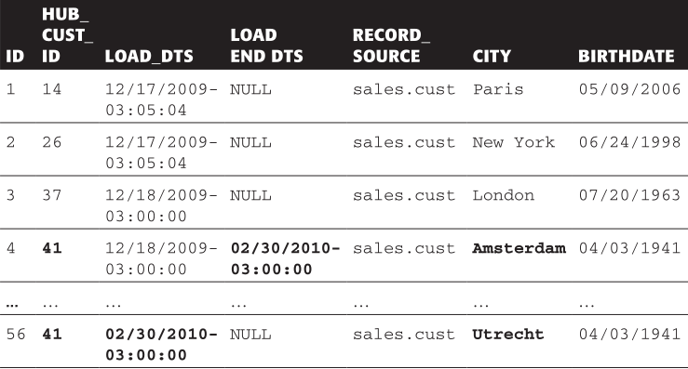
Sample Satelite

Slide 11
Data Vault
Elias Nema
Lead Software Engineer
Elias_Nema@epam.com

